Slide 1
Capstone Engagement
Assessment, Analysis, and Hardening of a Vulnerable System

Slide 2
Table of Contents
This document contains the following sections:
01
Network Topology
02
Red Team: Security Assessment
03
Blue Team: Log Analysis and Attack Characterization
Hardening: Proposed Alarms and Mitigation Strategies
04

Slide 3
Network Topology
3

Slide 4
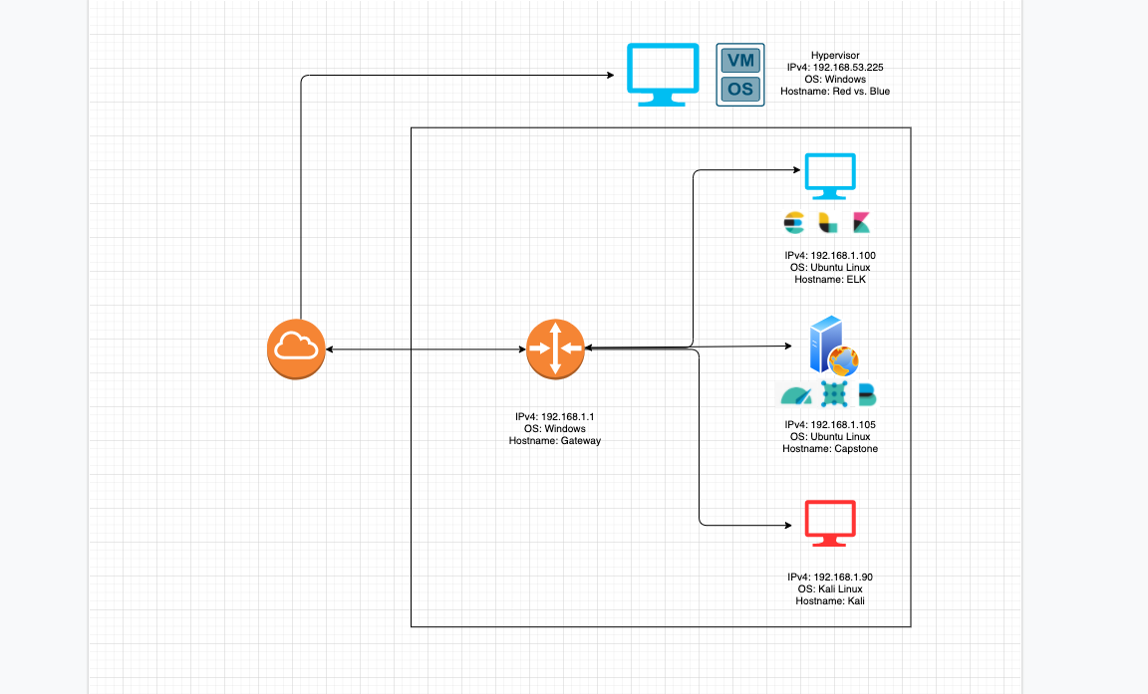
Network Topology
[Insert Here]
Use draw.io to create a diagram of the network.
Add your diagram to this slide and fill out the data in the sidebar.
Network
Address Range: 192.168.1.0/24
Netmask: 255.255.255.0
Gateway: 192.168.1.1
Machines
IPv4: 192.168.1.100
OS: Ubuntu Linux
Hostname: ELK
IPv4: 192.168.1.105
OS: Ubuntu Linux
Hostname: Capstone
IPv4: 192.168.1.90
OS: Kali Linux
Hostname: Kali
IPv4: 192.168.1.1
OS: Windows
Hostname: Gateway

Slide 5

Red Team
Security Assessment
5

Slide 6
Recon: Describing the Target
Nmap identified the following hosts on the network:
Hostname | IP Address | Role on Network
ELK Machine | 192.168.1.100 | ELK Server
Capstone Server | 192.168.1.105 | Apache HTTP WebDav Server
Kali Linux | 192.168.1.90 | Red Team PenTest Machine
Windows Gateway | 192.168.1.1 | Default Gateway Router

Slide 7
Vulnerability Assessment
The assessment uncovered the following critical vulnerabilities in the target:
Vulnerability | Description | Impact
Sensitive Data Exposure CWE-200 | Information included in the public facing code, text, and documents that reveals personal Identifiable information like a name or employment information. | This allows attackers to narrow their field of focus through enumeration to further define/refine their attack surface.
Brute Force Vulnerability CVE-2020-14494 | A BFV consists of an attacker configuring predetermined values, making requests to a server using those values, and then analyzing the response. | This allows attackers to run values, such as passwords, through software that will guess predetermined strings until a favorable response returns.
PHP Remote File Inclusion CVE-2006-2849 | This allows attackers to execute malicious code remotely | This allows attackers to gain backdoor access via a reverse TCP connection
GAO Report 08-536, Privacy: Alternatives Exist for Enhancing Protection of Personally Identifiable Information, May 2008, http://www.gao.gov/new.items/d08536.pdf.
https://owasp.org/www-community/attacks/Brute_force_attack
https://cwe.mitre.org/data/definitions/200.html

Slide 8
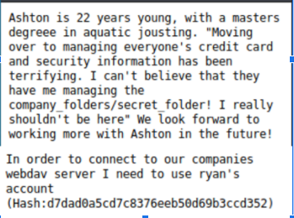
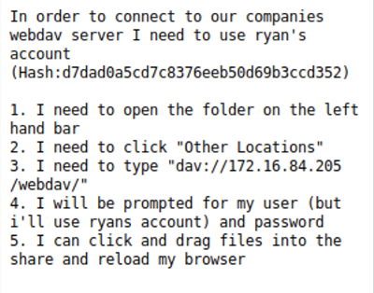
Exploitation: Sensitive Data Exposure
01
02
03
Tools & Processes
Utilize nmap to scan the local network to enumerate which server is the target machine.
Access the vulnerable server through the IP address listed.
Scan the Webdav pages for Sensitive Data Exposure.
Achievements
This exploit allowed us to find the Webdav server.
Find three important pieces of information:
secret_folder
Ryan M. C.E.O
Ashton is the manager of direct communication
Ashton manages the secret folder
Ryan manages the webdav folder

Slide 9
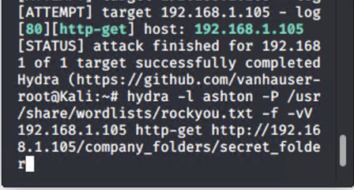
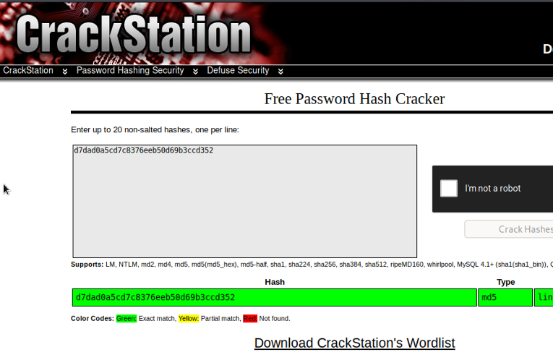
Exploitation: Brute Force Vulnerability
01
02
03
Tools & Processes
Utilize the hydra and the enumerated web pages to crack the passwords.
Command:
Hydra -l ashton -P /usr/share/wordlists/rockyou.txt -f -vV 192.168.1.105 http-get http://192.168.1.105/company_folders/secret_folder
Achievements
After running the command, we found ashton’s login credentials:
Username: ashton
Password: leopoldo
We then used the hash provided in the secret folder to crack ryan’s password using crackstation:
username : ryan
Password: linux4u
[INSERT: screenshot or command output illustrating the exploit.]

Slide 10
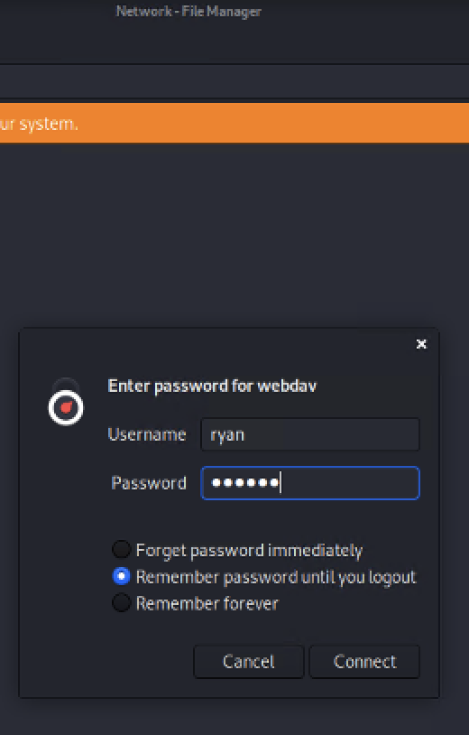
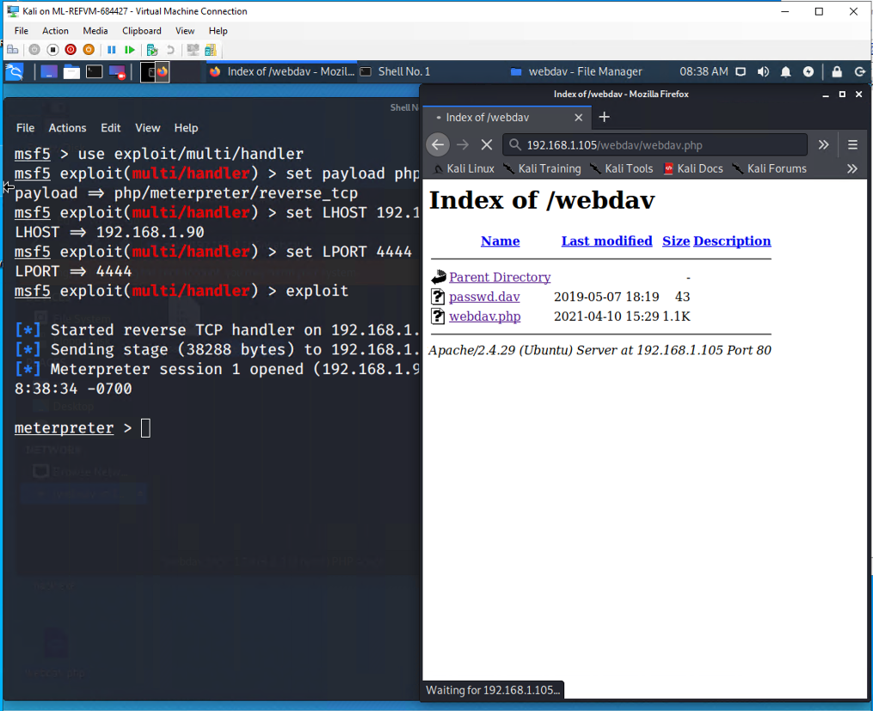
Exploitation: Local File Inclusion/Unauthorized File Upload
01
02
03
Tools & Processes
After cracking the password hash for ryan’s account, we then could add the WebDav file share to our Network Files manger.
This will allow us to upload the malicious PHP script that we later execute for a reverse tcp connection.
Achievements
This allowed us to upload the malicious PHP script to initiate a reverse tcp connection.
Msfvenom was used to build the script.
Msfconsole was used to open the meterpreter session that ultimately allowed us a remote connection to find the flag.
[INSERT: screenshot or command output illustrating the exploit.]

Slide 11

Blue Team
Log Analysis and Attack Characterization
11

Slide 12
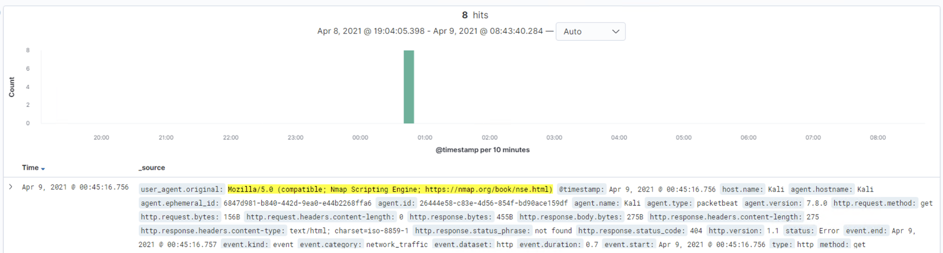
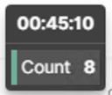
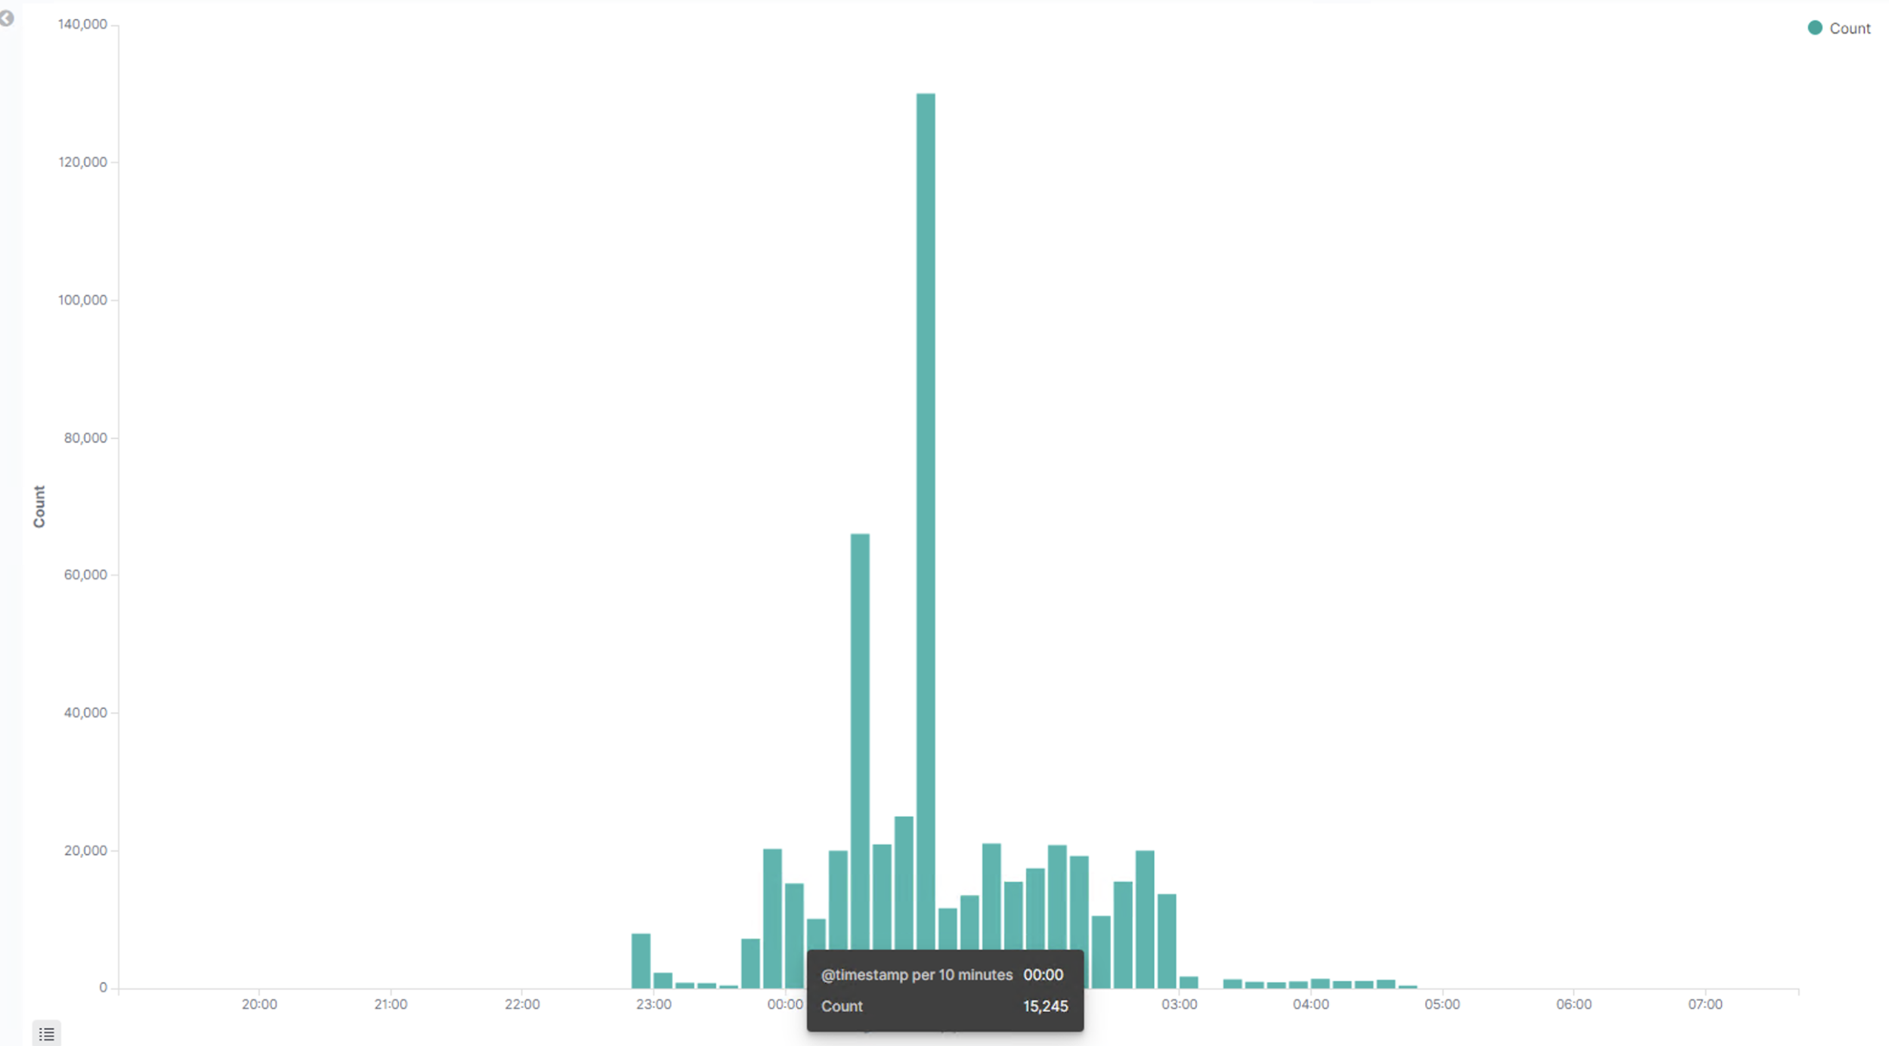
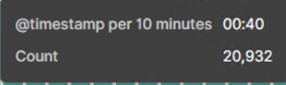
Analysis: Identifying the Port Scan
We know the port scan occurred at 0:45 on 04-09-2021 from 192.168.1.90
After analyzing the network flow, we can approximate that 20,932 packets were sent during the scan.
The user_agent was used to indicate that a port scan occurred by utilizing nmap (top).
The network_flow indicated the amount of packets sent (right).

Slide 13
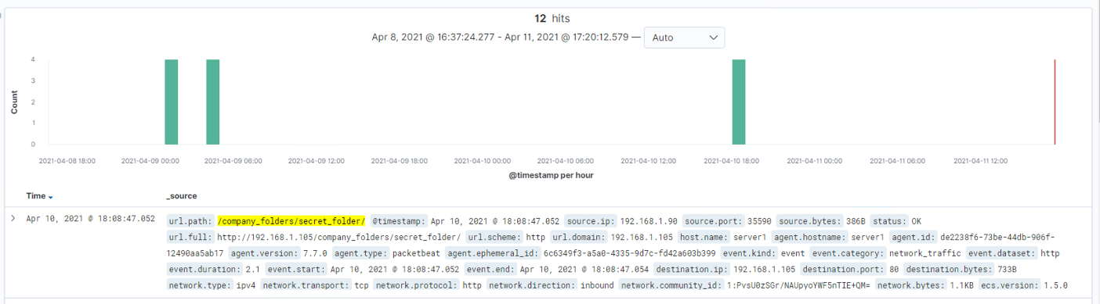


Analysis: Finding the Request for the Hidden Directory
Requests for the hidden /secret_folder/ directory started at 1:00pm
12 Requests total were made from IP address 192.168.1.90
The Connect_to_corp_server text file was the file that the attackers accessed.

Slide 14
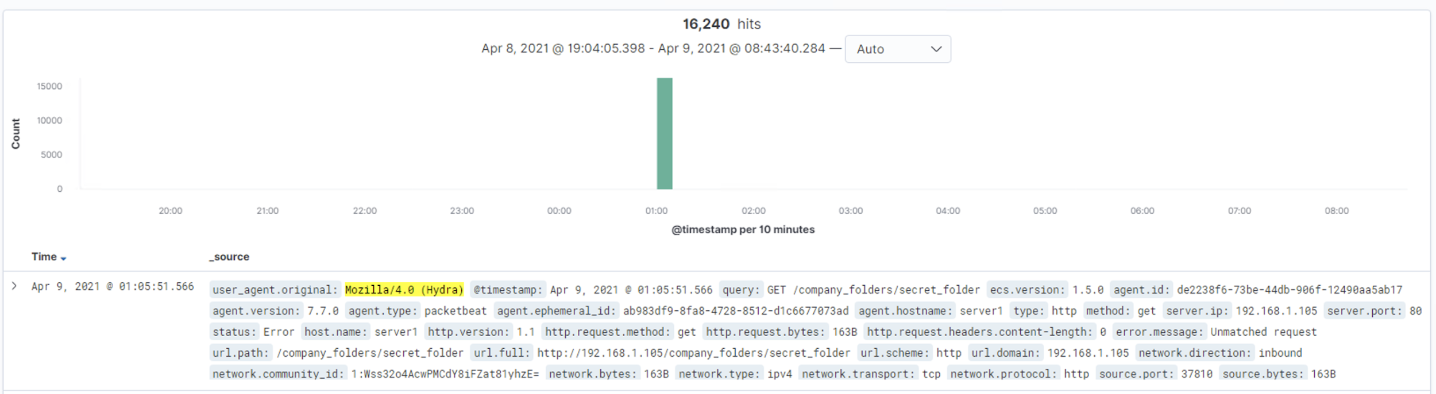
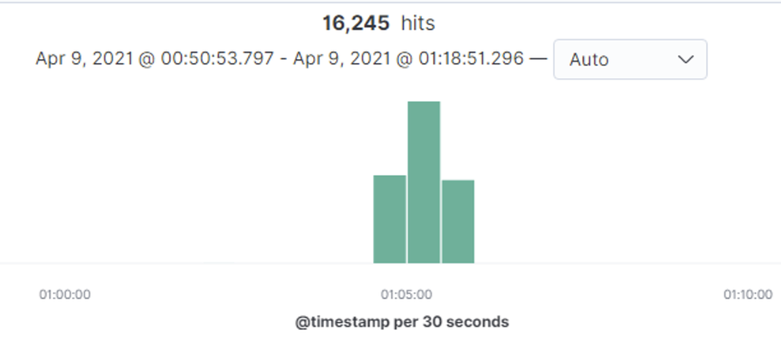
Analysis: Uncovering the Brute Force Attack
16,245 requests were made during the attack.
16,240 requests were made by the attacker before the correct password was discovered.
A user_agent search was used to determine the attacking software used is Hydra (top)
An http.status_code: 401 search was used to determine the total attempts made (right).
HTTP 401 Unauthorized

Slide 15
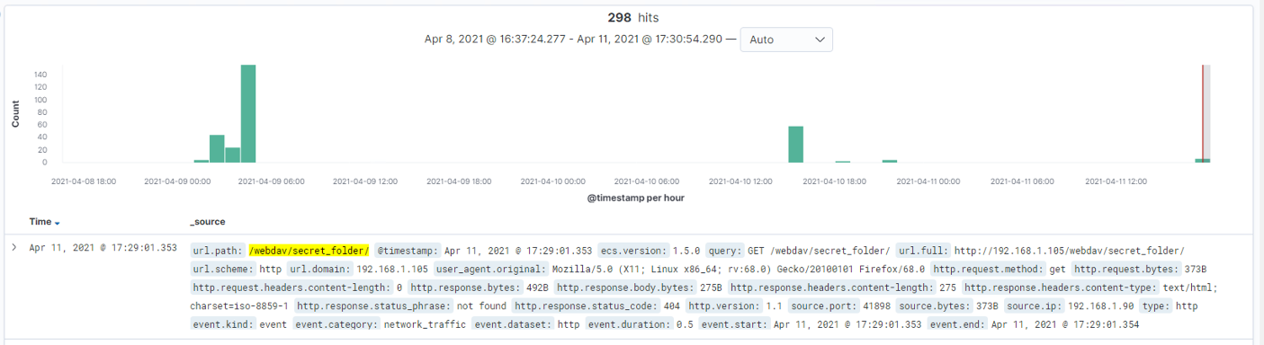
Analysis: Finding the WebDAV Connection
298 requests were made to the /WebDav folder during the attack
The files requested were the passwd.dav file and the webdav.php file
The webdav.php was the malicious payload that granted remote access to the attacker.

Slide 16
Blue Team
Proposed Alarms and Mitigation Strategies
16

Slide 17
Mitigation: Blocking the Port Scan
An alarm can be sent when nmap is located in the user.agent_original field to notify the system administrator when a port scan is occurring on the local network.
A threshold of 1 verified nmap user agent is sufficient from a non-whitelisted IP address.
An alarm can also be set when more than 500 connections are made within a 5 minute period.
Configure the network firewall to detect and respond to any port scan attempt in real time.
Conduct regular in-house port scans to ensure vulnerable ports are not open to malicious actors.
Set server firewall to drop packet traffic when connection thresholds are exceeded.
Regularly patch firewalls and software to avoid zero-day attacks.

Slide 18
Mitigation: Finding the Request for the Hidden Directory
To detect unauthorized access requests for hidden folders, I would block all incoming HTTP traffic when the source IP originates outside whitelisted company IP addresses.
A threshold should be set to a maximum of 10 attempts per hour before a triggered alert is sent to the system administrator.
Sensitive files should not be open to the public facing file systems. An alternative to the Web Distributed Authoring and Versioning (WebDAV) service should be explored.
In the meantime, sensitive information/data should be encrypted and the folders should only be accessed by whitelisted IP addresses.
VPN tunneling could also be a solution that will provide infrastructure towards continuing security improvements.

Slide 19
Mitigation: Preventing Brute Force Attacks
Send an email alert and lock the account when more than 20 bad login attempts are made.
Create a dashboard item that tracks HTTP 401 Unauthorized client error statuses and the associated IP address.
Send an alert when the user agent indicates usage of Hydra or any other credential stuffing software.
Implementation of more complex passwords that are 8-12 characters in length with at least one number and one symbol included.
Account lockout policy that triggers a 30 minute waiting period after 20 bad login attempts.
A running blacklist and whitelist of IP addresses that trigger the lockout alert. If a lockout effects an employee, a password locker/education may be necessary.

Slide 20
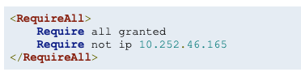
Mitigation: Detecting the WebDAV Connection
Restrict access to sensitive portions of the linux server and website with:
mod_authz_host
Uncomplicated Firewall (UFW)
iptables
Firewalld
Block all HTTP traffic originating outside of a whitelisted company IP address to the WebDAV folder.
Email the system administrator when more than 5 HTTP GET requests are made to the folder from a single IP source outside the company whitelist.
Email the system administrator of any HTTP PUT request made to the folder from outside the company whitelist.
https://docs.rackspace.com/support/how-to/block-an-ip-address-on-a-Linux-server/

Slide 21
Mitigation: Identifying Reverse Shell Uploads
Block all http PUT requests from IP addresses outside of the company whitelist.
Set access to the WebDAV folder to read only to prevent any unwanted executable files from being uploaded.
Close/Block any ports that are not necessary to continue with business operations.
Alert the system administrator when any http PUT request is recorded to sensitive folders from an IP address outside of the company whitelist.
Alert the system administrator when an attempt is made to access port 80, 4444, and 1337 from all network traffic.
The previous alert can be paused if/when remote access is needed by the I.T. dept. for scheduled maintenance purposes.

